Slide 1
Hanwash Indicator Performance

Slide 2
H.I.P
Accessibility of the platform

Slide 3
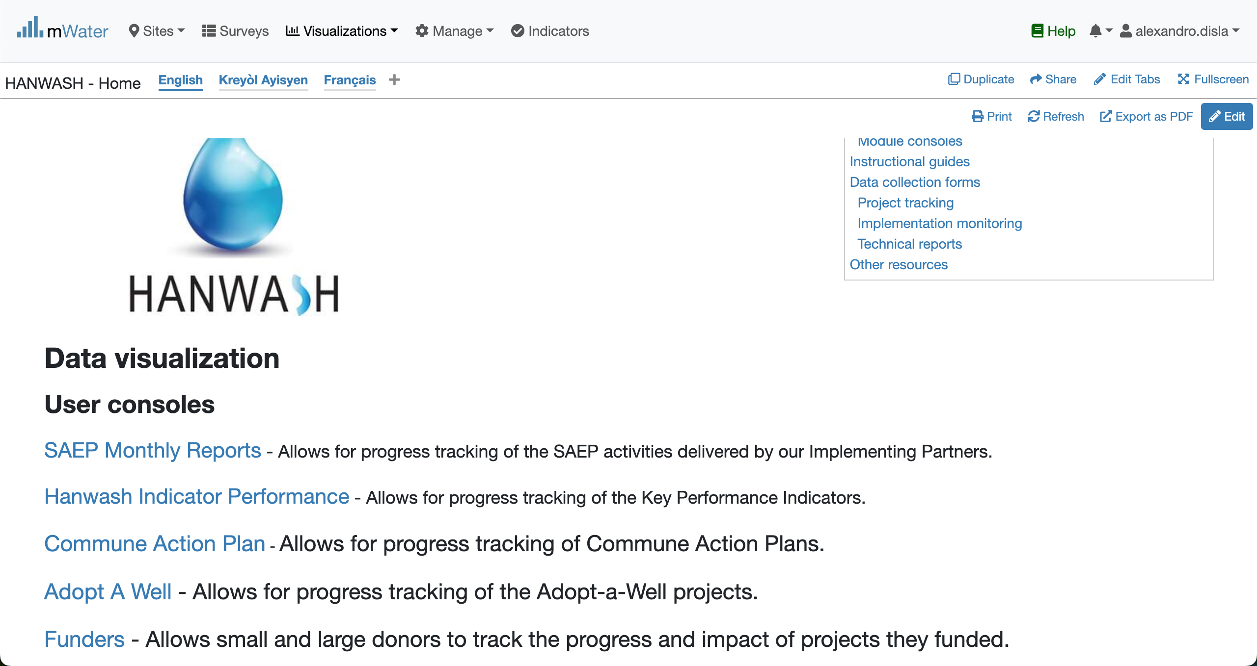
Hanwash HOME
URL LINK : http://go.mwater.co/hanwash

Slide 4
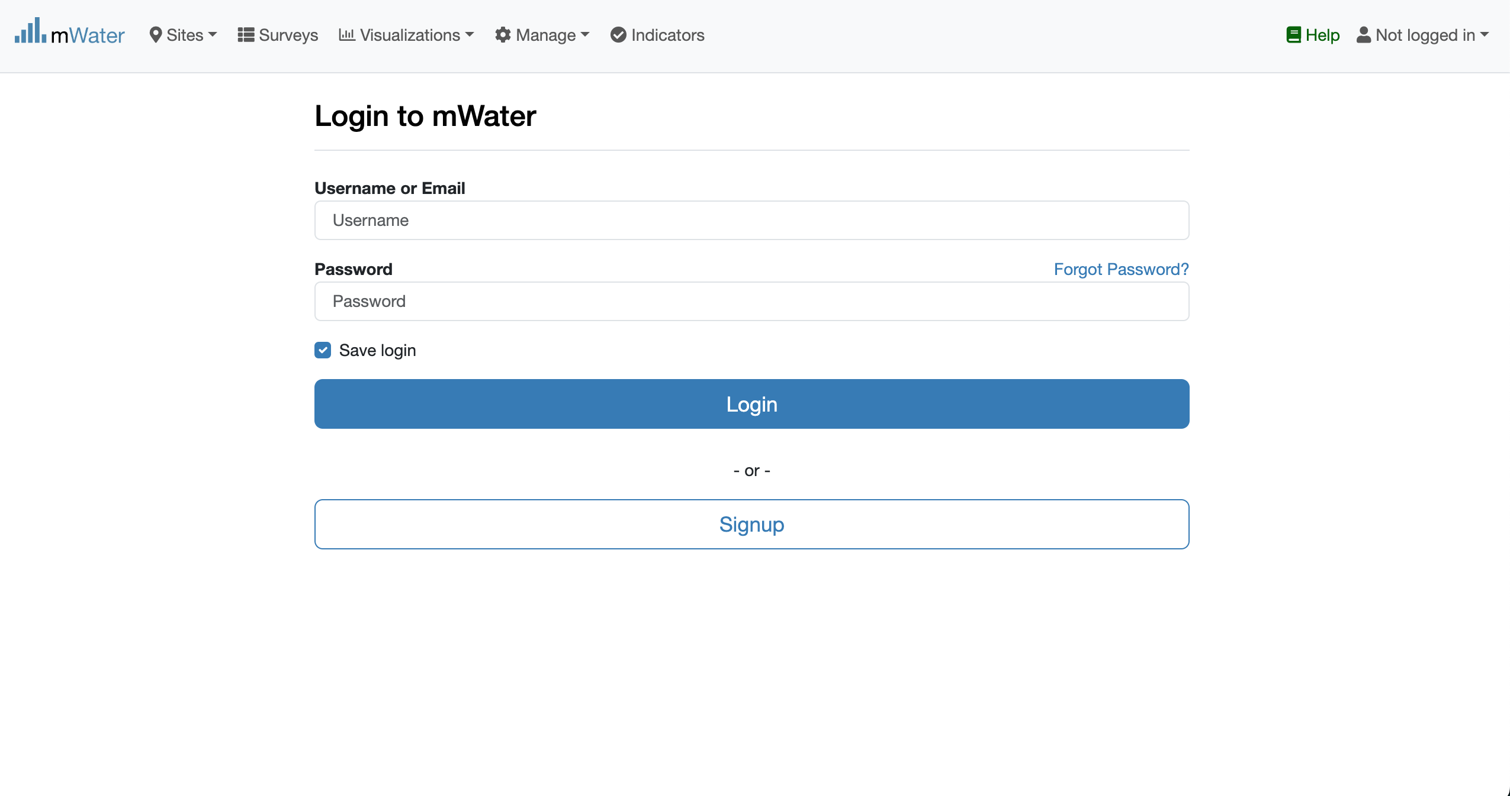
Access The HIP & Login process
Click on the HIP url link
Log status indicator
Please enter your Credentials

Slide 5

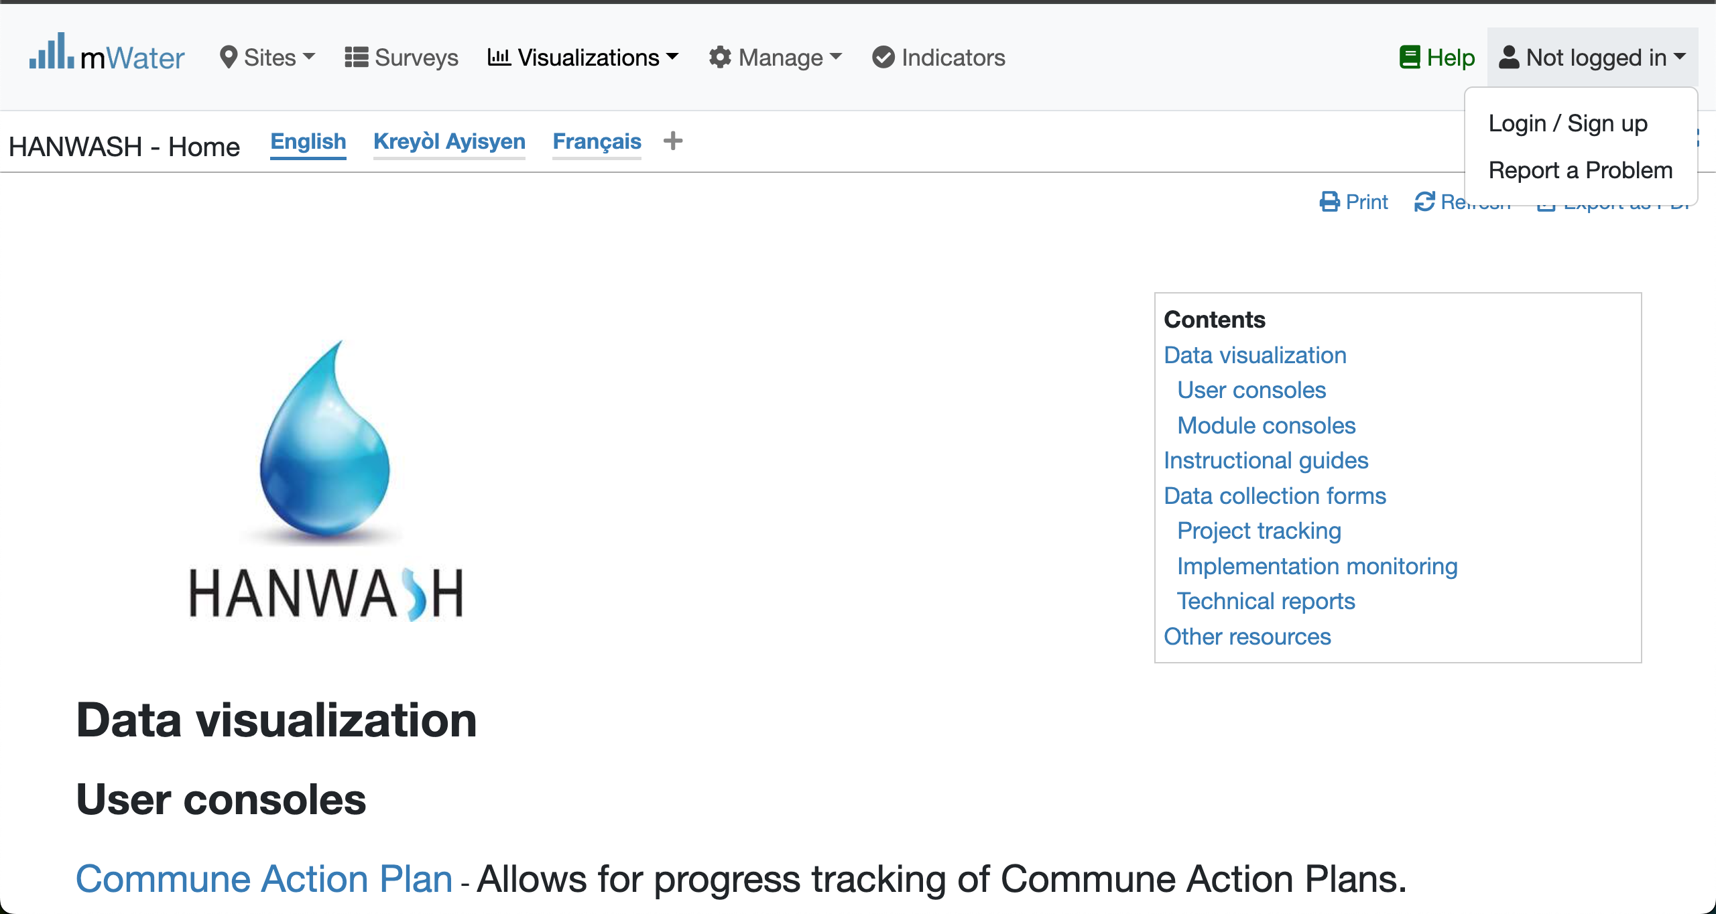


Login Process (2nd scenario)
Click to Login or Signup
Please Click on this selection box
Please enter your Credentials

Slide 6
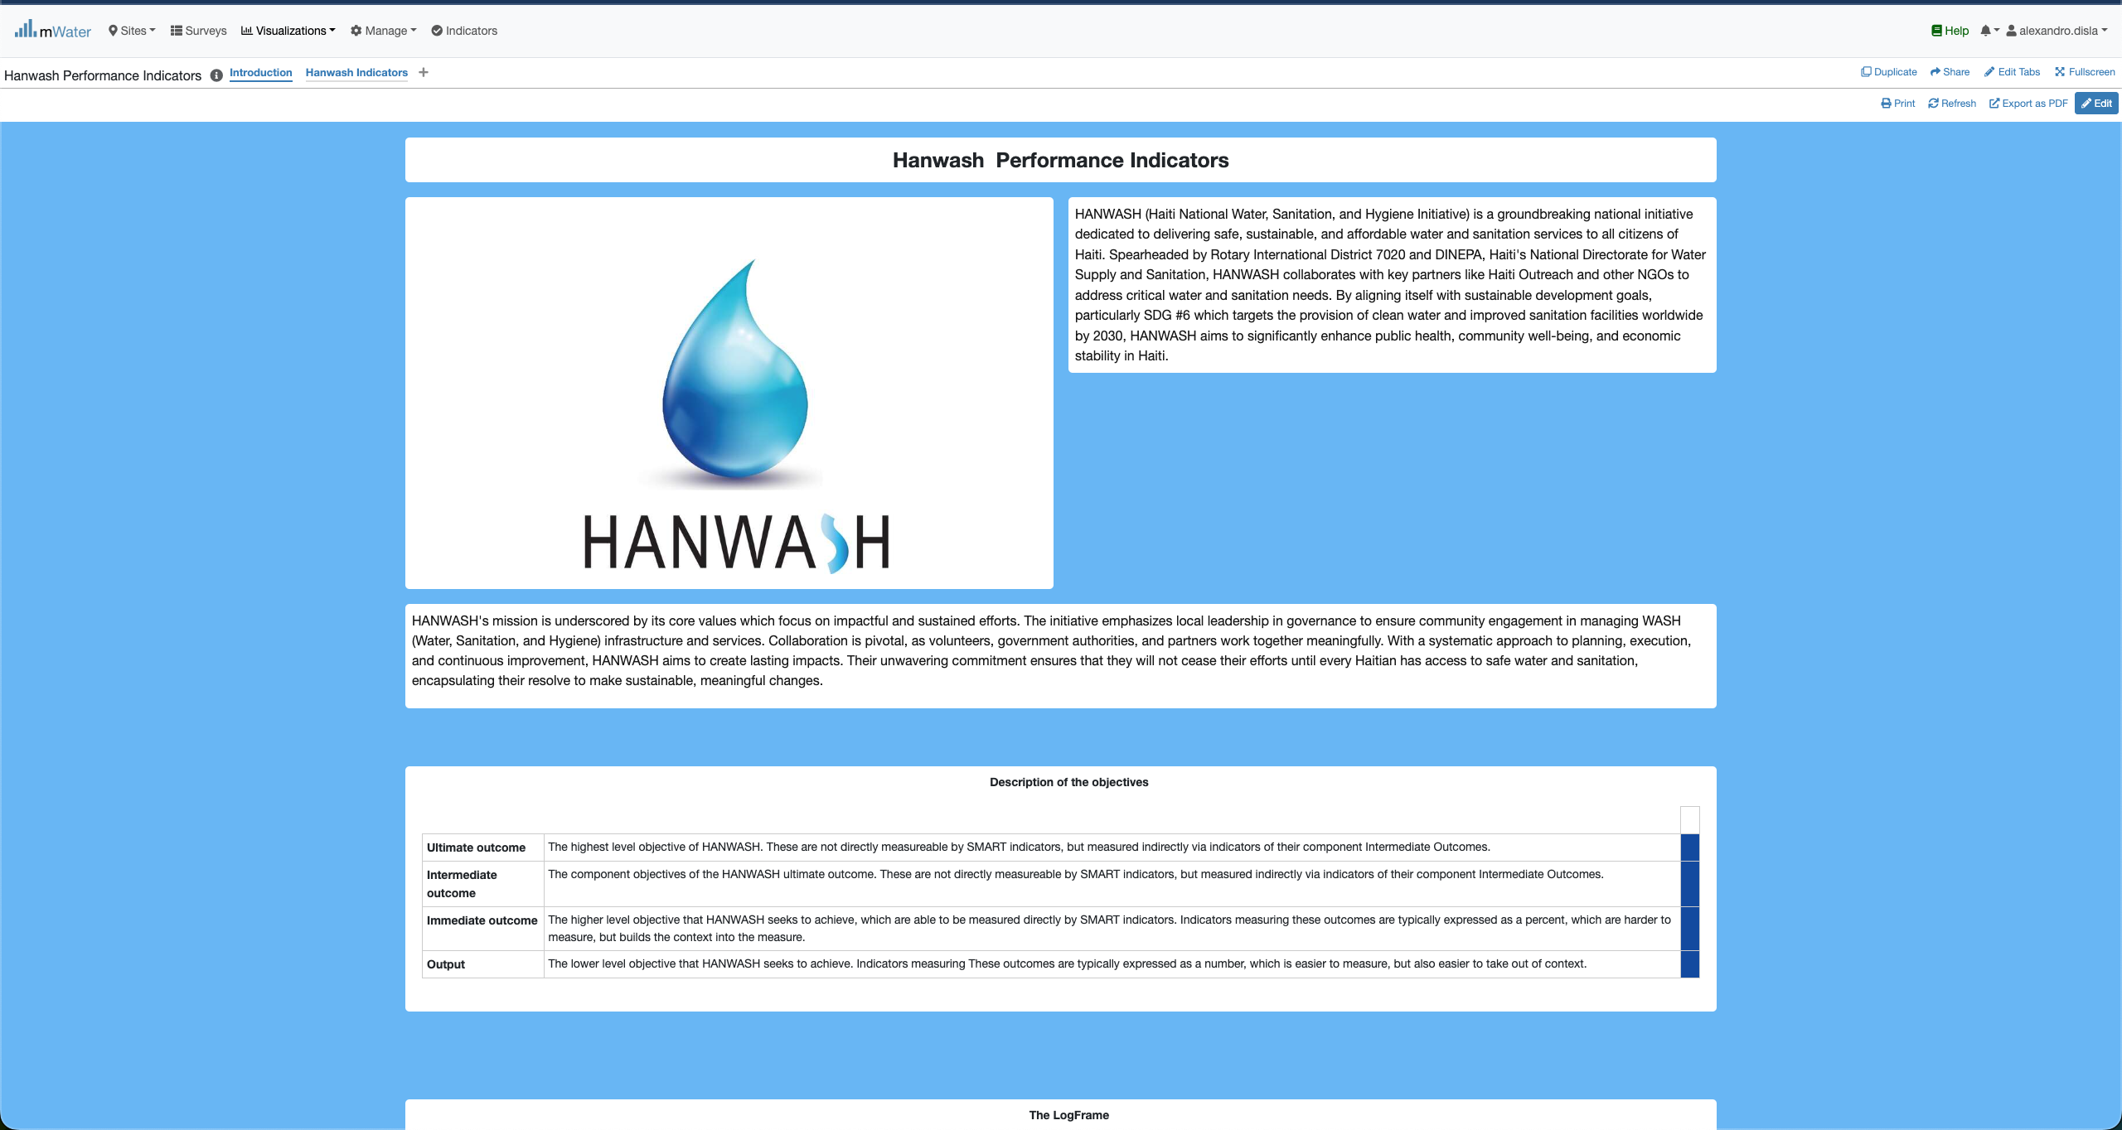
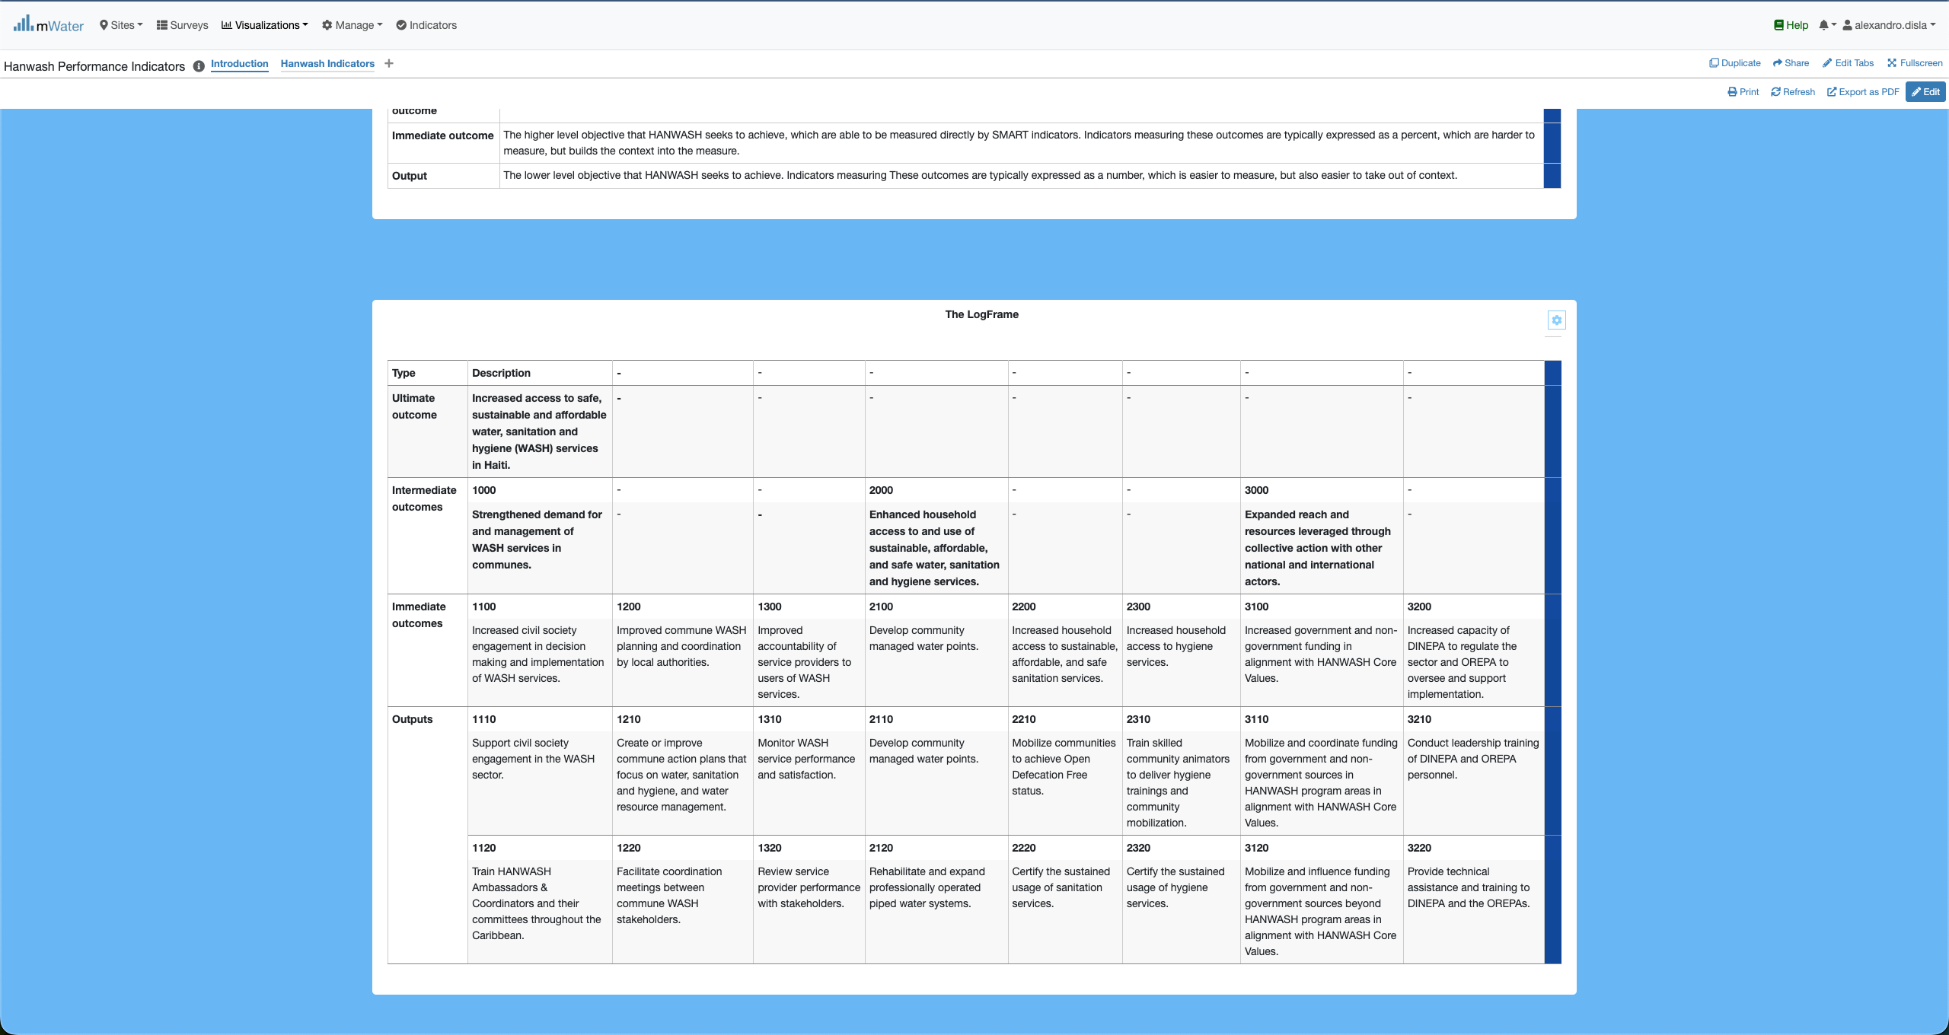
HIP Console overview

Slide 7
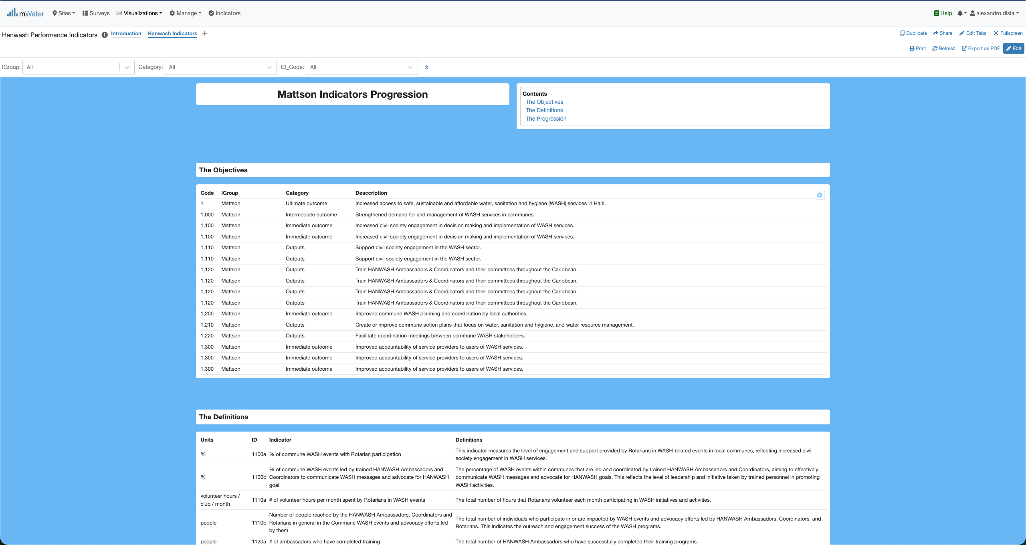
HIP Console overview

Slide 8
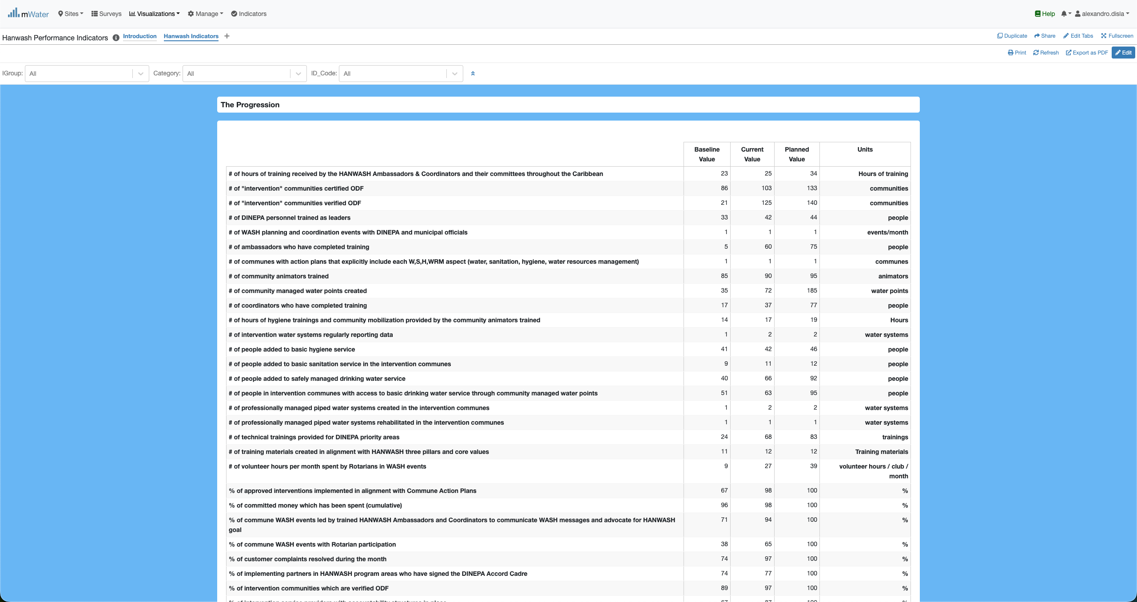
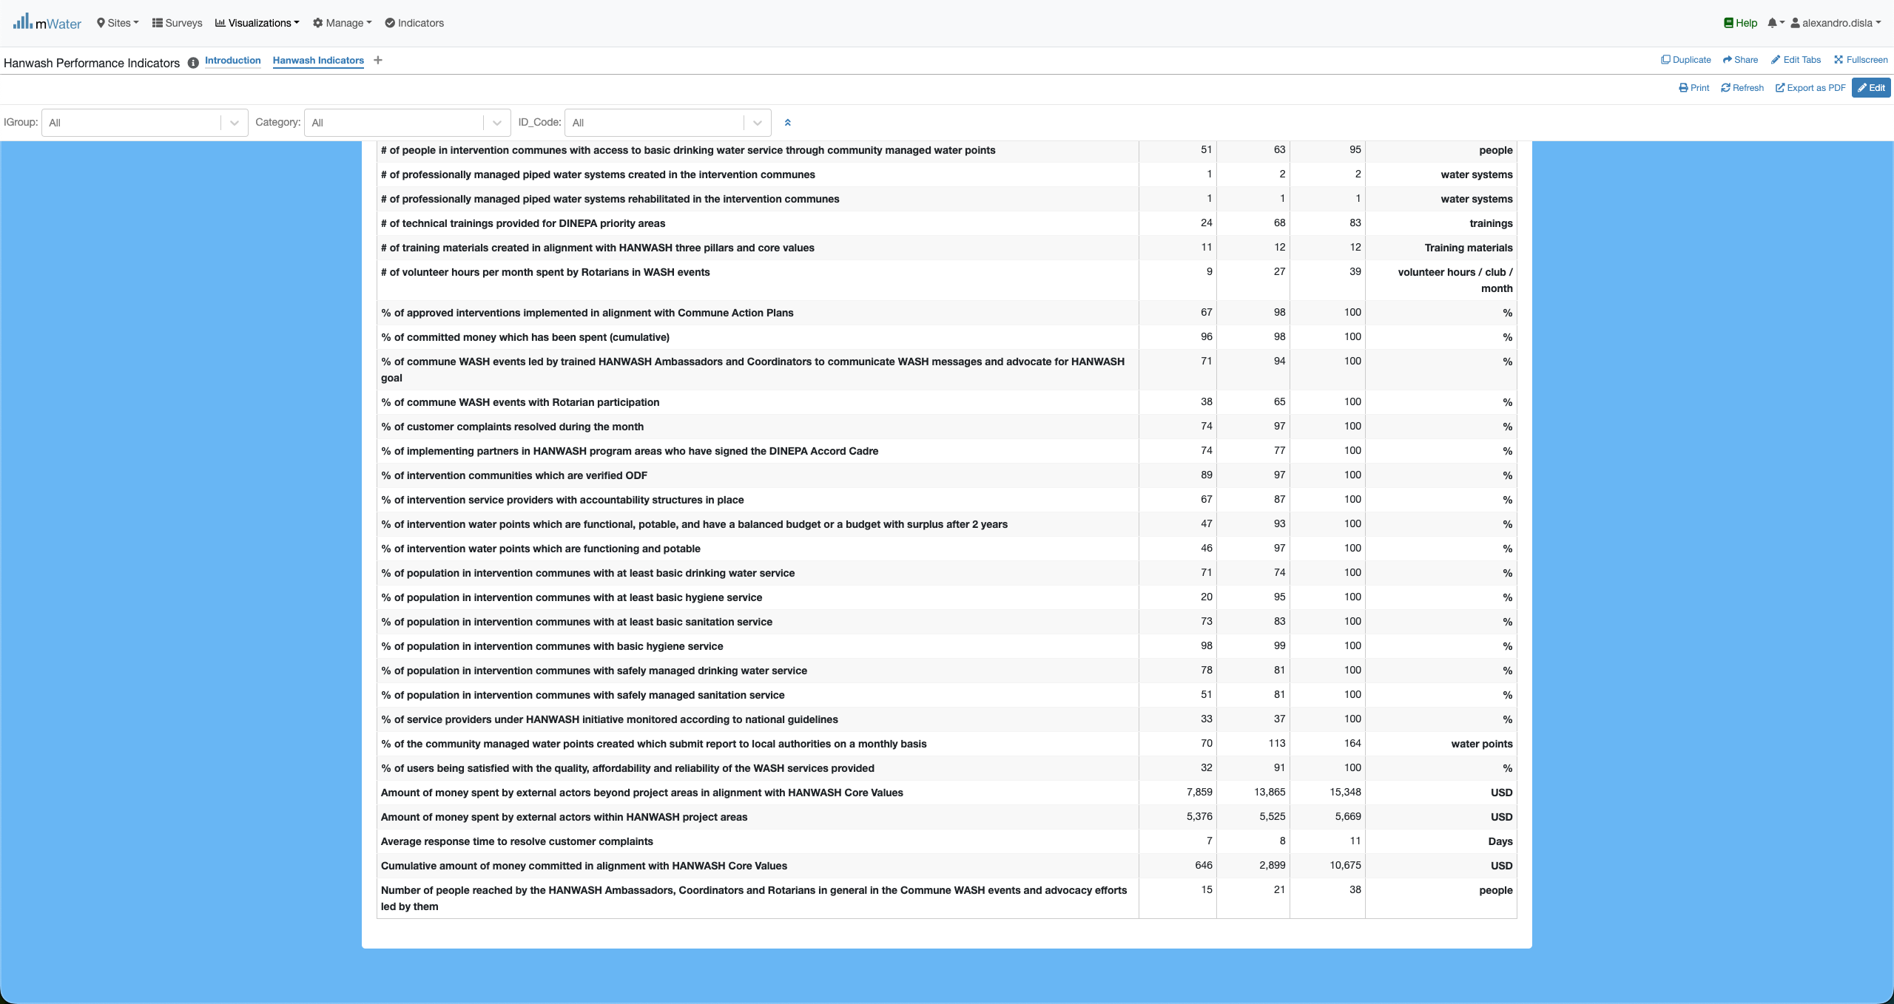
HIP Console overview

Slide 9
Functionalities
Functionalities available in the console

Slide 10
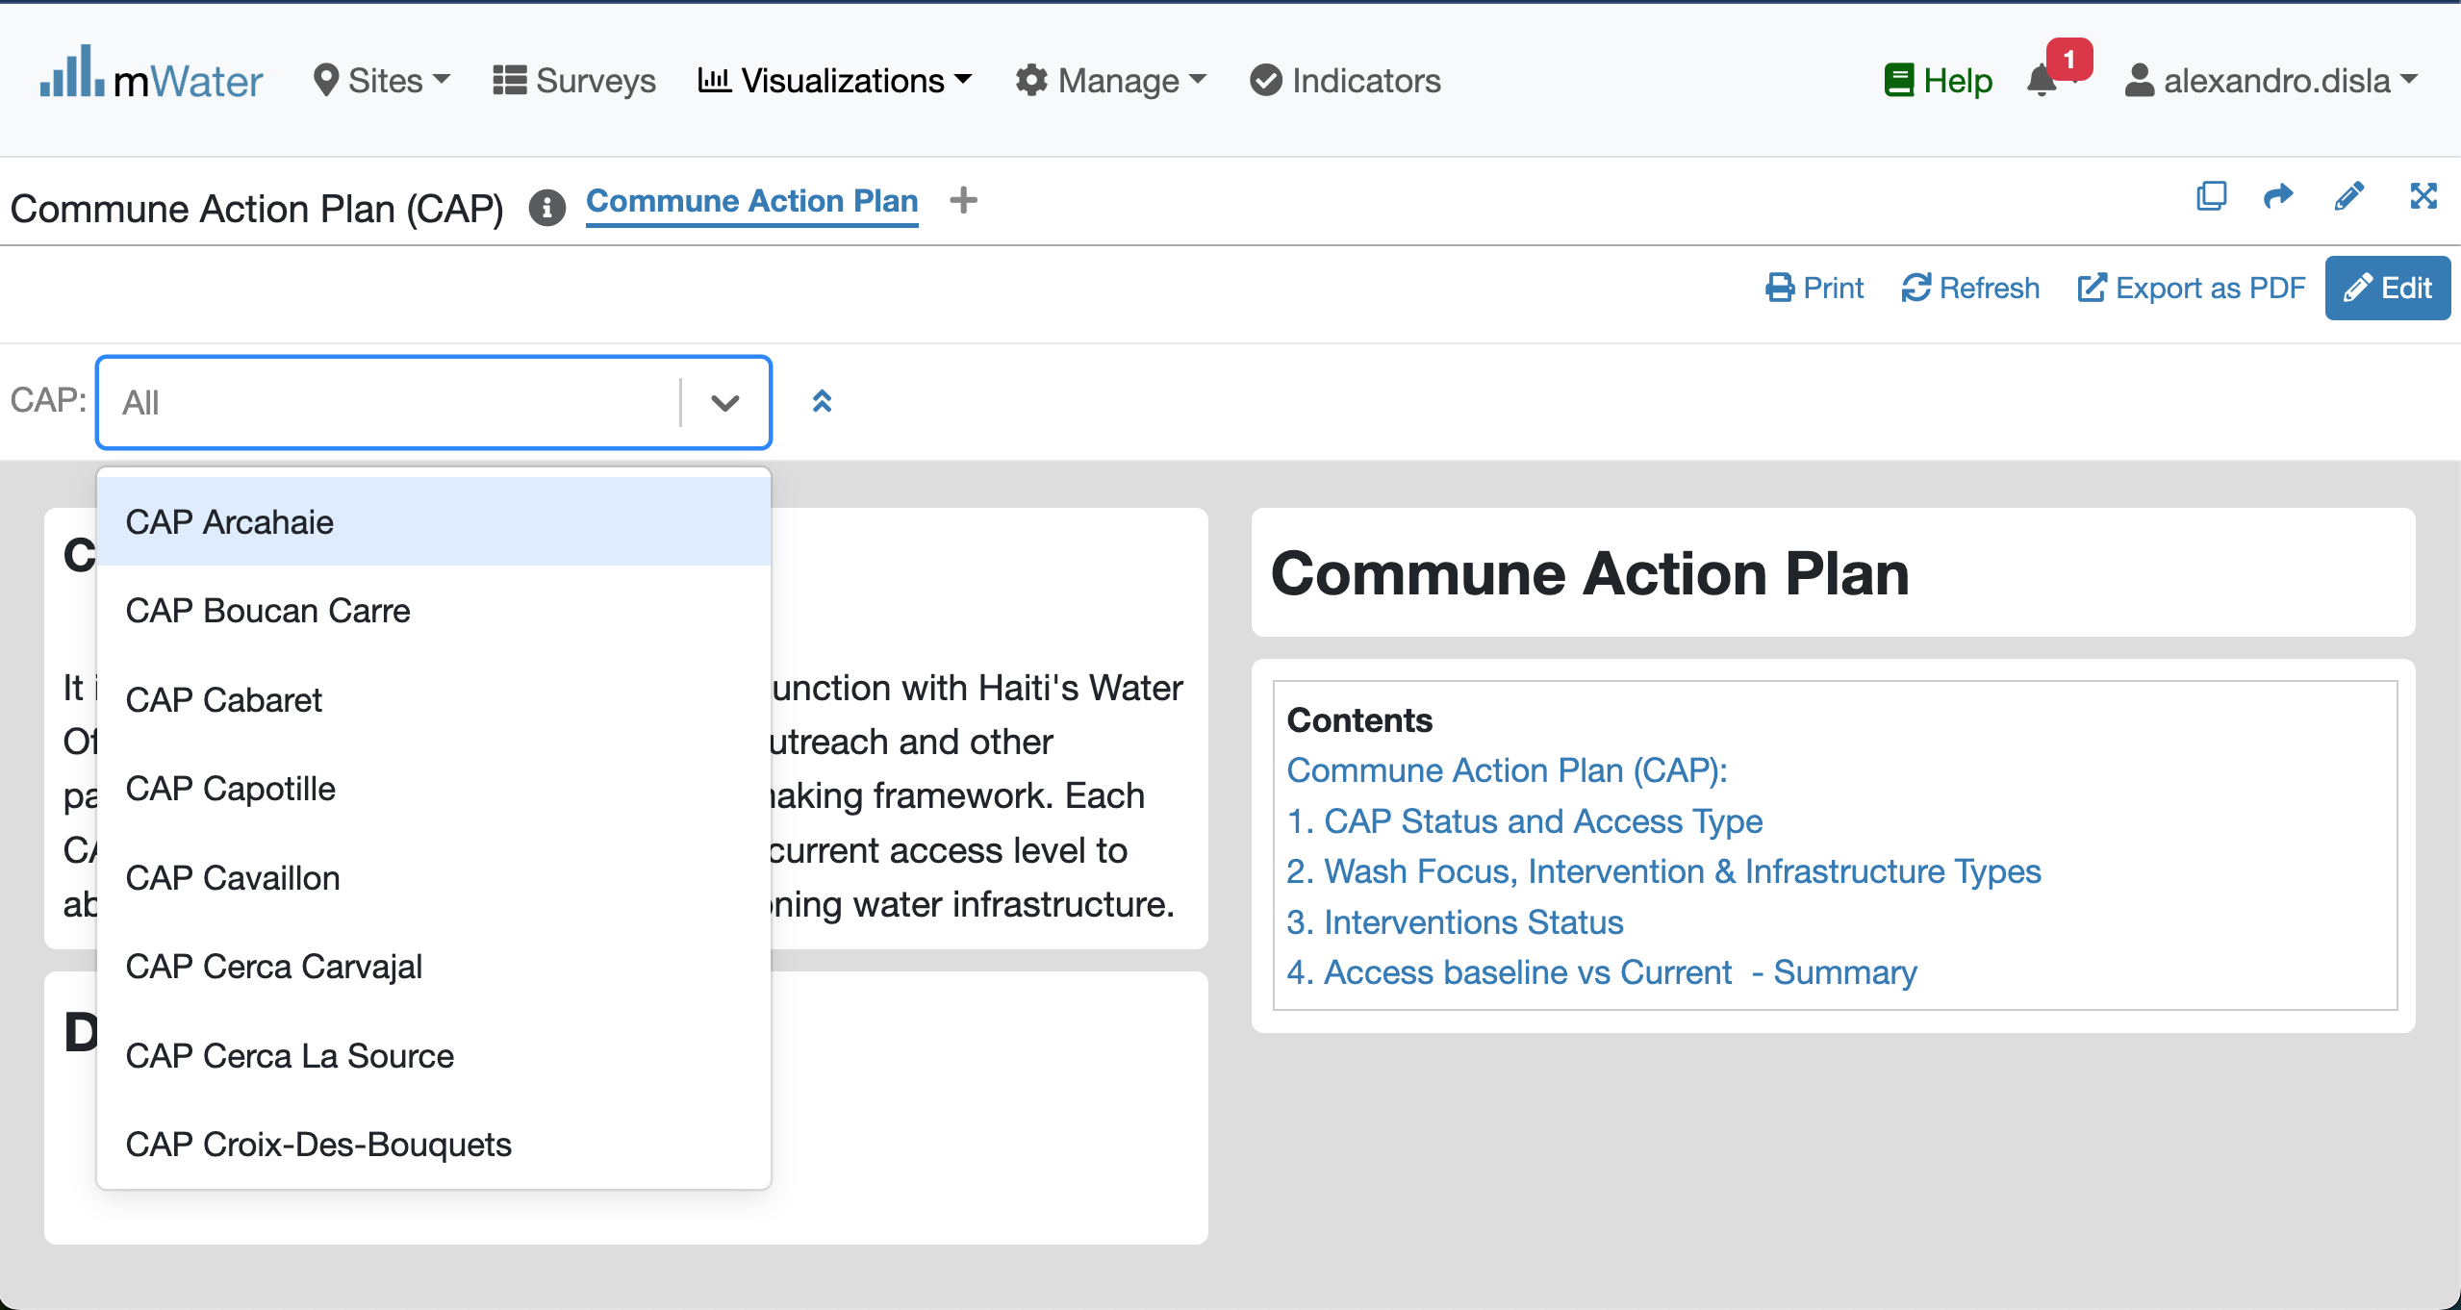
Quick filters
Click to get the dropdown list
Please select one CAP unit

Slide 11
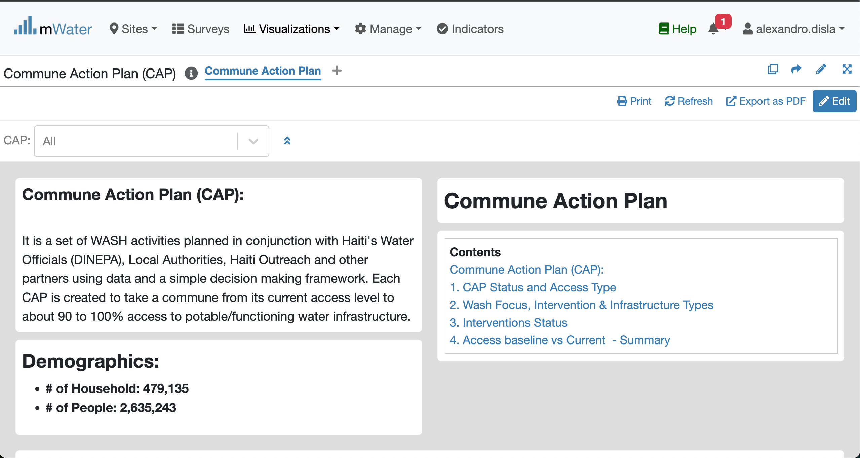
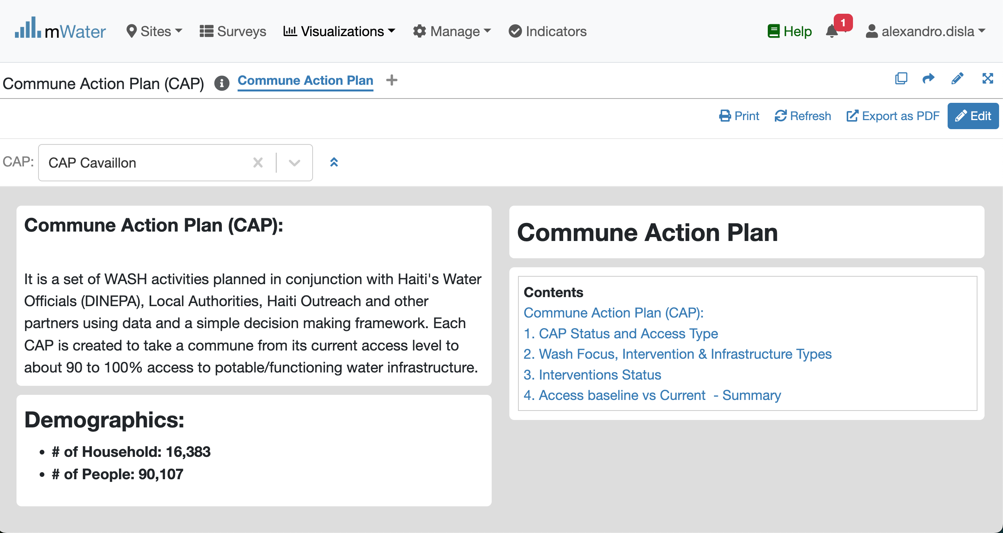
Effect of the Quick Filters

Slide 12
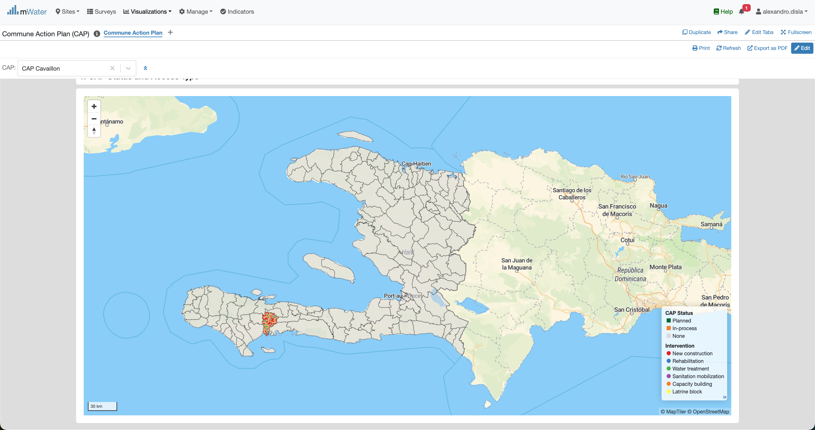
The Map

Slide 13
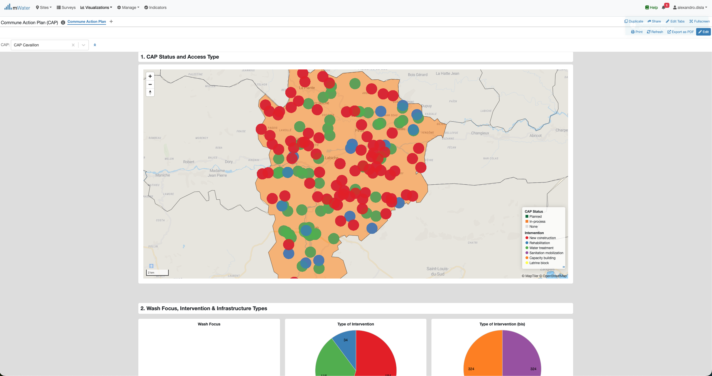

The map- Zoom
Zoom Control
Help you go over the map.

Slide 14
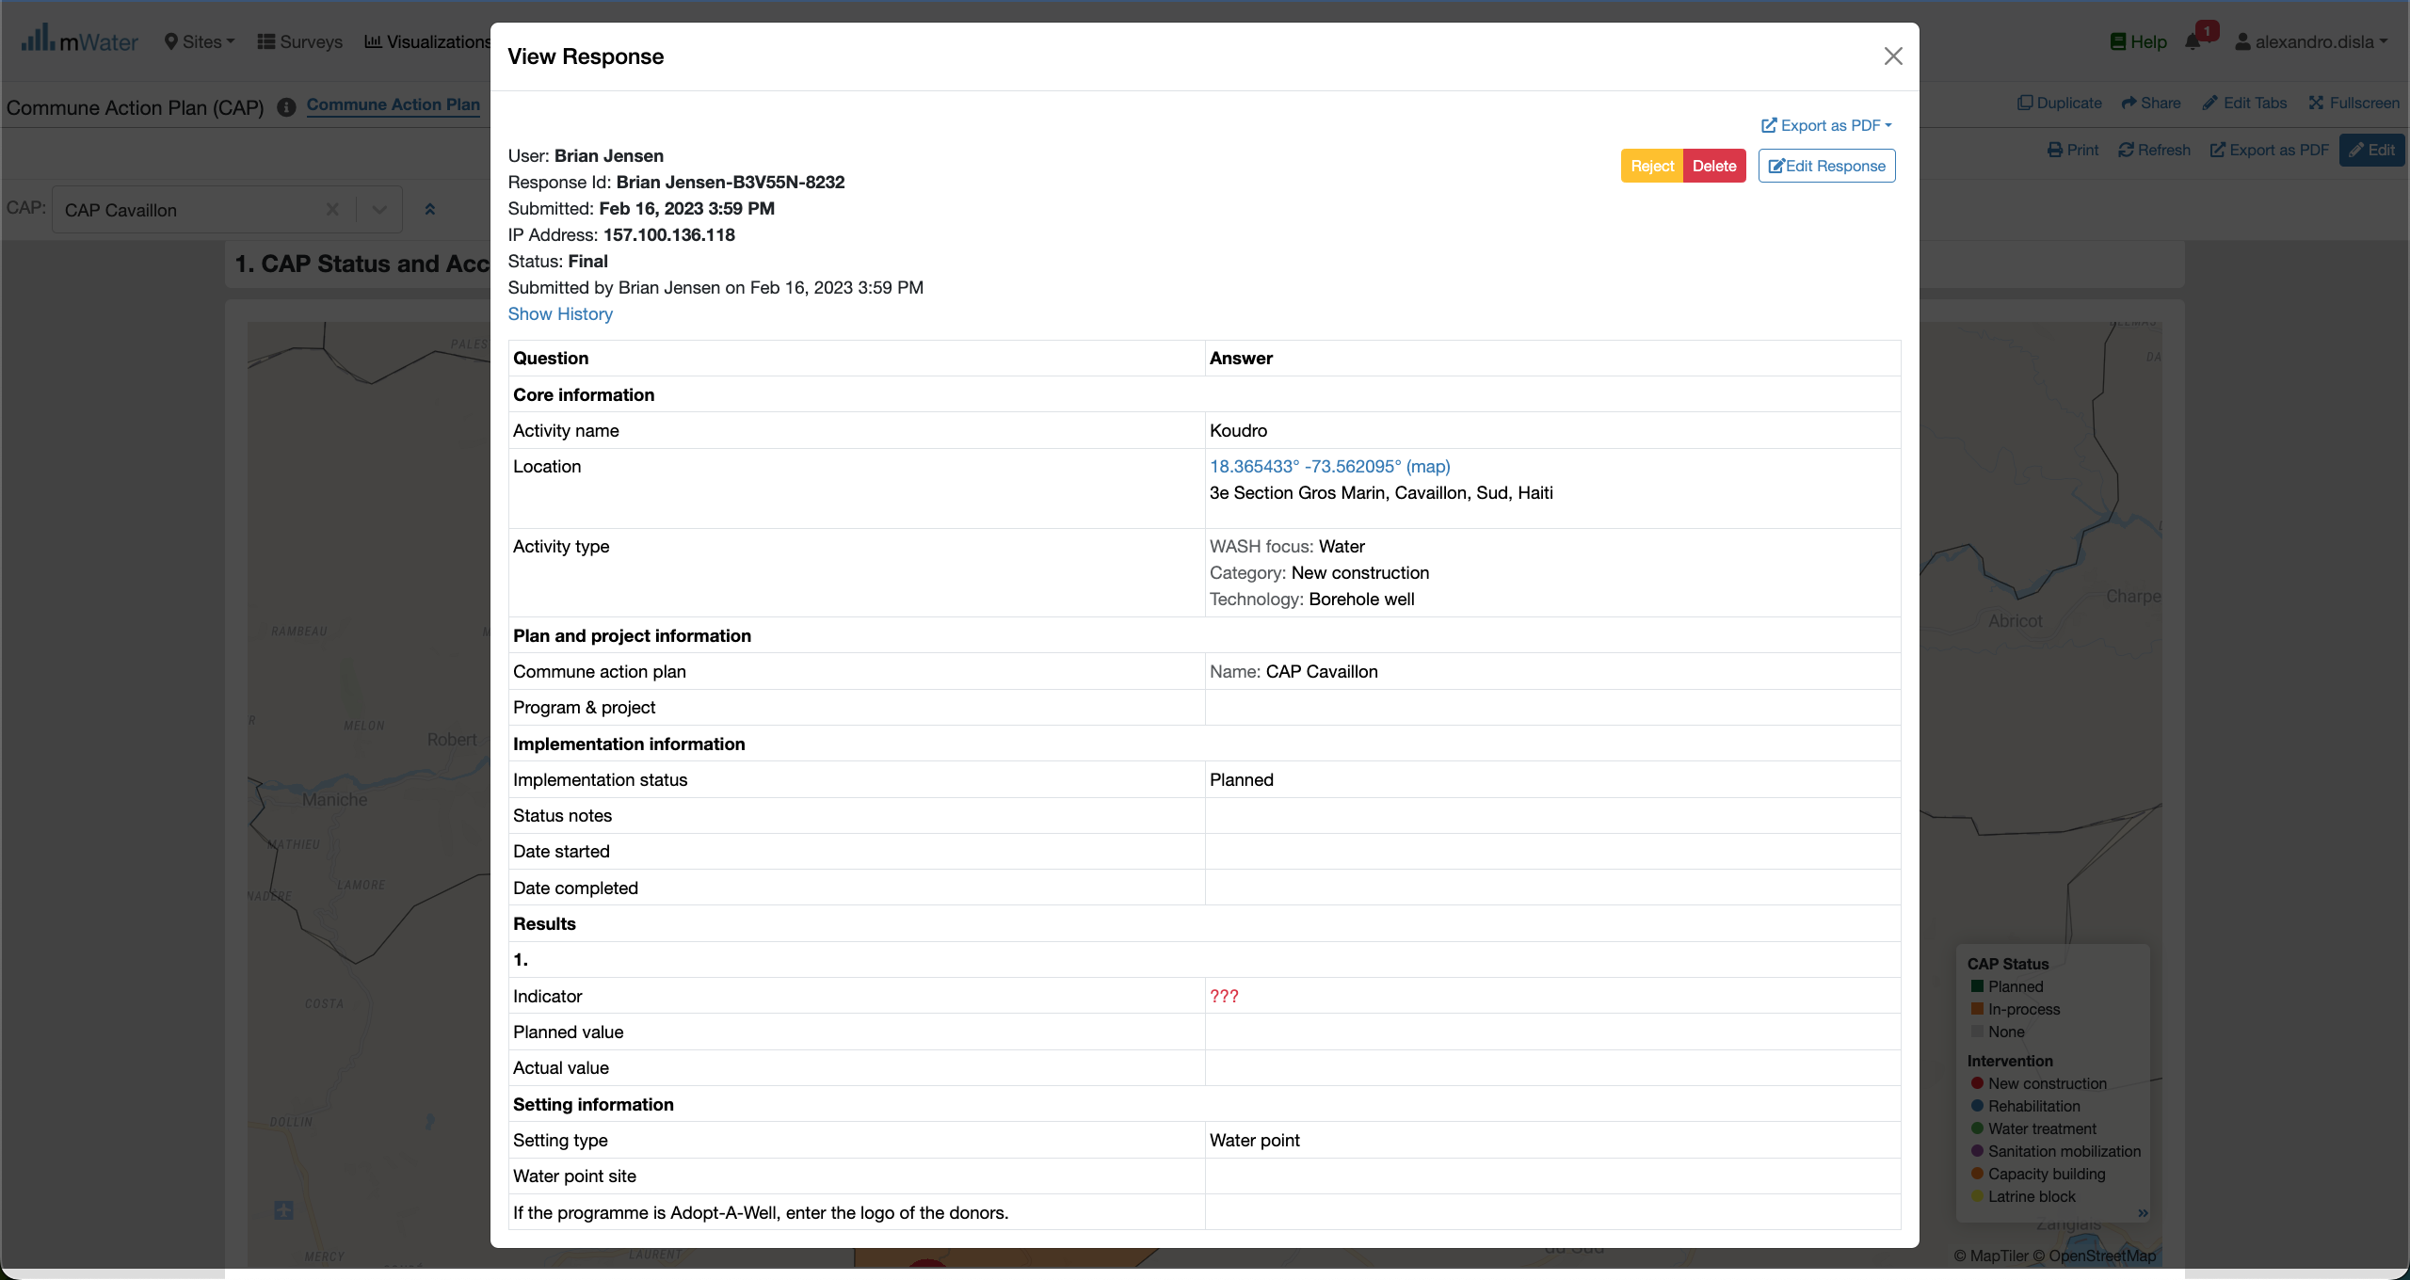
MAP – selection of a Point

Slide 15
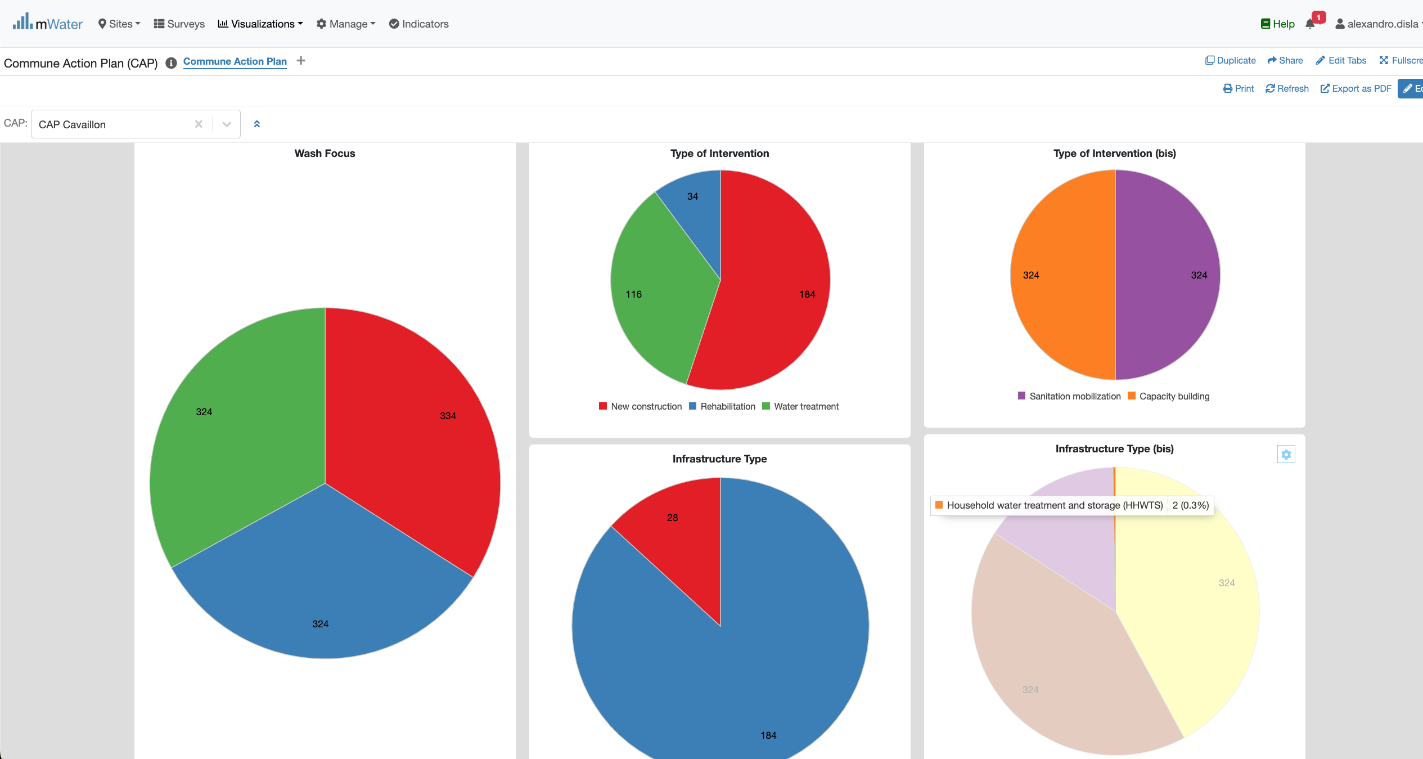
Pie Charts
Instant Hover Effect

Slide 16
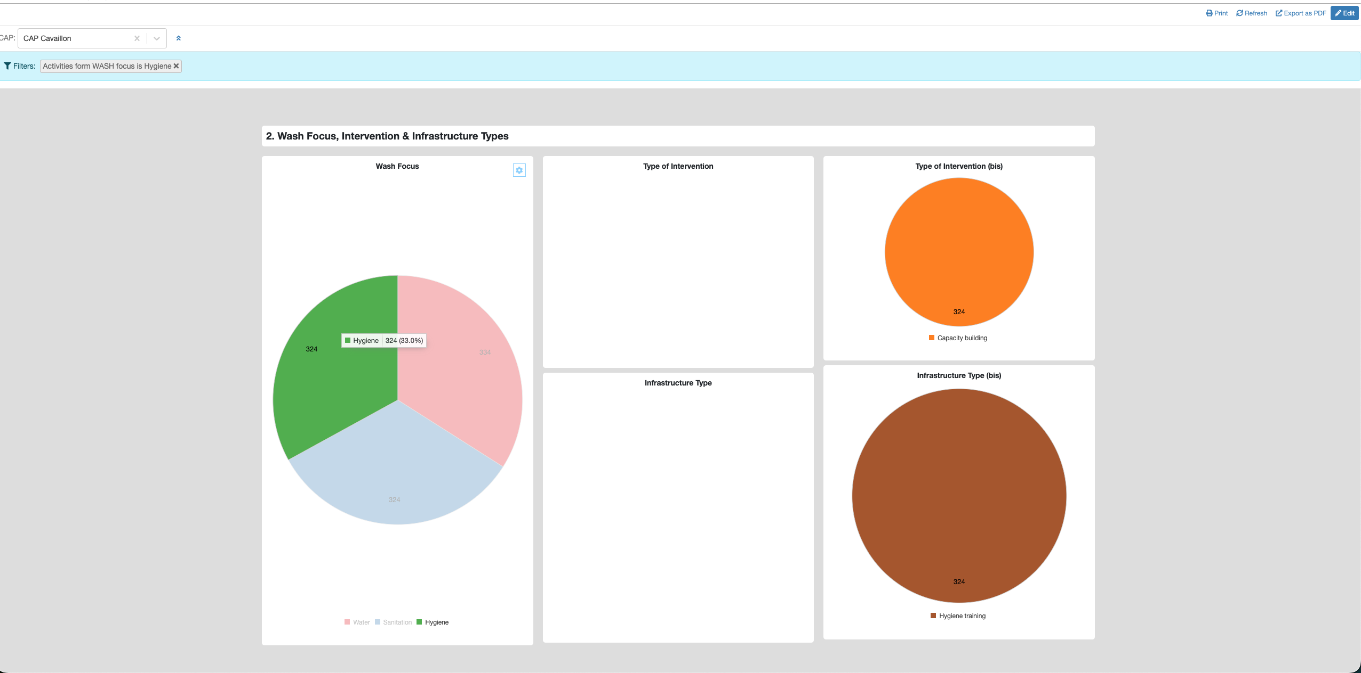
Pie Charts
Click on the x button to close this filter view
A new filter view is now open
Click on a wash focus
The cluster react to the selection

Slide 17
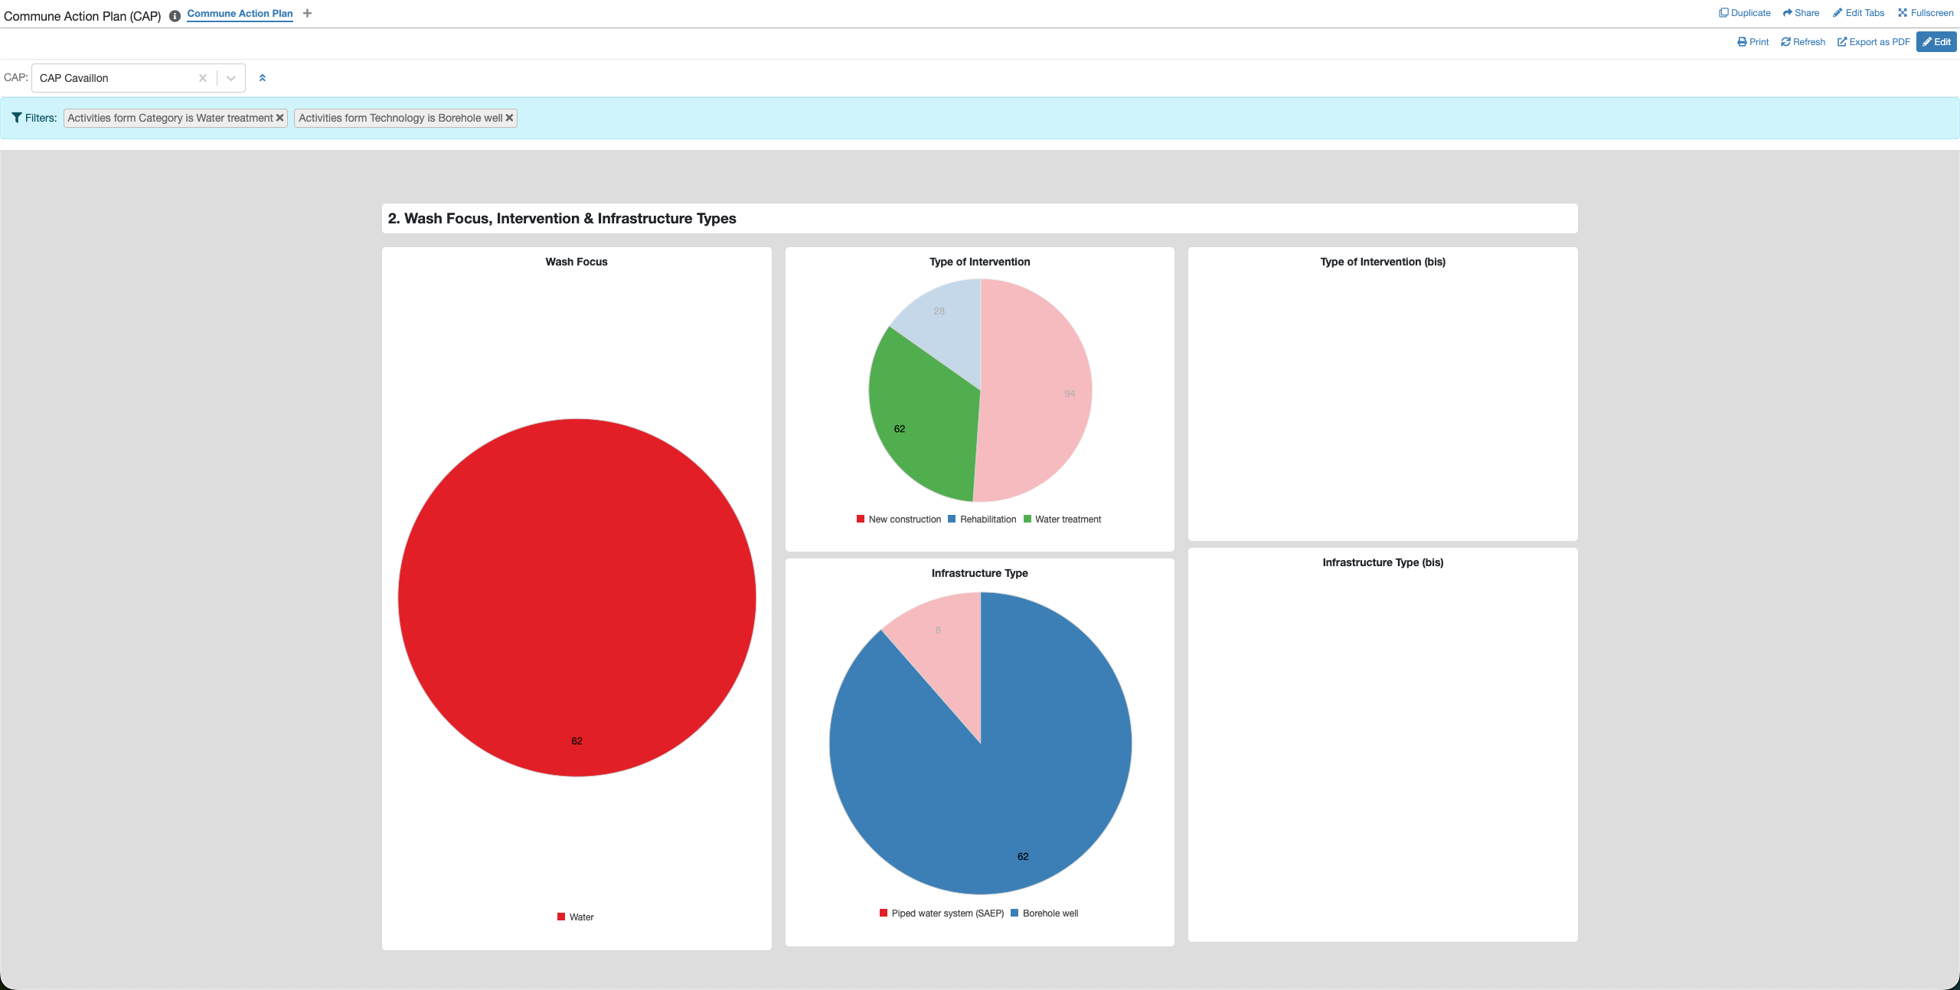
Pie Charts
When it make sense, you can select segment from different related pie charts
The filter view support multiple selection. If the logic make sense.

Slide 18
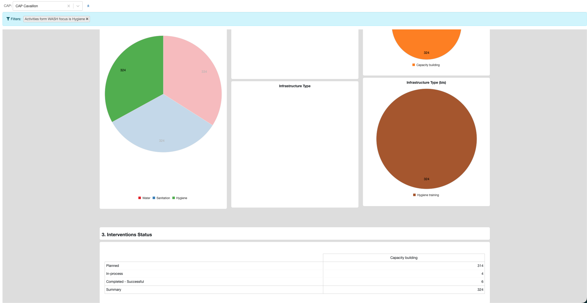
Pivot table & Pie CHarts
One of the wash focus has been selected
The filter View.
The table will redisign itself to make sense
The pivot table is link logically with the pie chart cluters

Slide 19
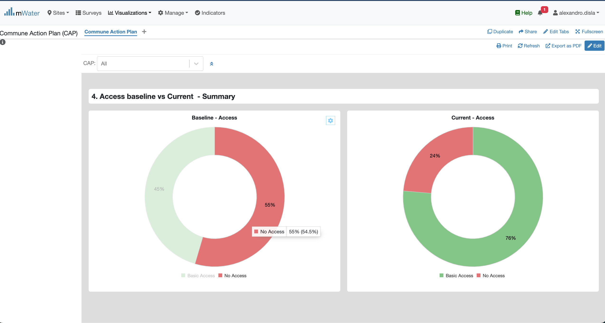
Donut Charts
Hover Effect feature

Slide 20
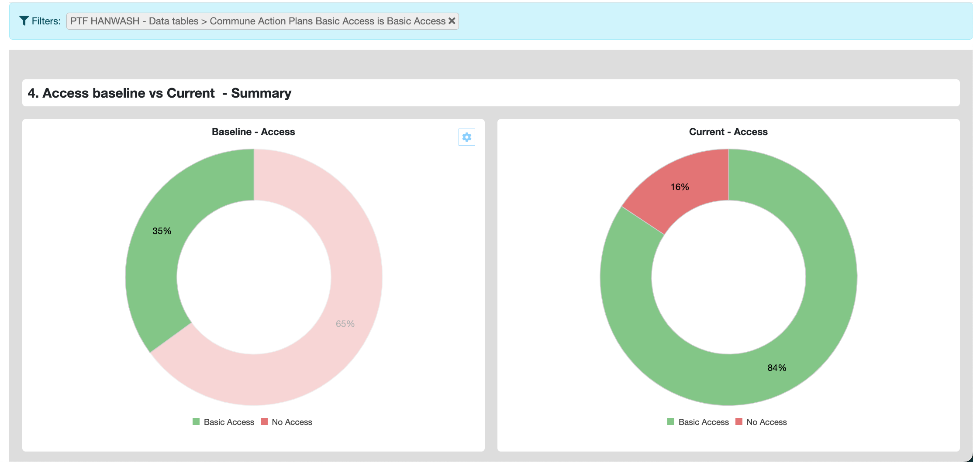
donut Charts

